Slide 1
Biodiversity

Slide 2
A World Rich in Biodiversity
Biodiversity, is the variety of organisms in a given area, the genetic variation within a population, the variety of species in a community, or the variety of communities in an ecosystem.
Certain areas of the planet, such as tropical rainforests, contain an extraordinary variety of species.
Humans need to understand and preserve biodiversity for our own survival.

Slide 3
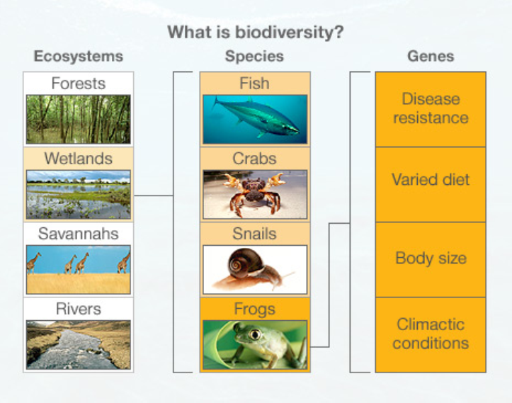

Slide 4
Unknown Diversity
The number of species known to science is about 1.7 million, most of which are insects. However, the actual number of species on Earth is unknown.
Scientists accept an estimate of greater than 10 million for the total number of species.

Slide 5
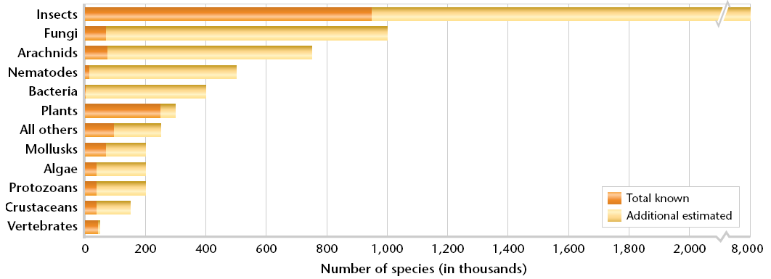
Unknown Diversity

Slide 6
Unknown Diversity
New species are considered known when they are collected and described scientifically.
Unknown species exist in remote wilderness, deep oceans, and even in cities.
Some types of species are harder to study and receive less attention than large, familiar species.

Slide 8
Levels of Diversity
Species diversity refers to all the differences between populations of species, as well as between different species.
Ecosystem diversity refers to the variety of habitats, communities, and ecological processes within and between ecosystems.
Genetic diversity refers to all the different genes contained within all members of a population.
A gene is a segment of DNA that is located in a chromosome and that codes for a specific hereditary trait.

Slide 9
Benefits of Biodiversity
Biodiversity can affect the stability of ecosystems and the sustainability of populations.
We depend on healthy ecosystems to ensure a healthy biosphere that has balanced cycles of energy and nutrients.
Species are part of these cycles.

Slide 10
Species Are Connected to Ecosystems
When scientists study any species closely, they find that it plays an important role in an ecosystem.
Every species is probably either dependent on or depended upon by at least one other species in ways that are not always obvious.
When one species disappears from an ecosystem, a strand in a food web is removed.

Slide 13
Species Are Connected to Ecosystems
A keystone species is a species that is critical to the functioning of the ecosystem in which it lives because it affects the survival and abundance of many other species in its community.
An example is the sea otter. The loss of the sea otter populations led to an unchecked sea urchin population, which ate all the kelp leading to the loss of kelp beds along the U.S. Pacific Coast.

Slide 14
Species and Population Survival
The level of genetic diversity within populations is a critical factor in species survival.
Genetic variation increases the chances that some members of the population may survive environmental pressures or changes.
Small and isolated populations are less likely to survive such pressures.

Slide 15
Species and Population Survival
When a population shrinks, its genetic diversity decreases as though it is passing through a bottleneck.
Even if such a population is able to increase again, there will be inbreeding within a smaller variety of genes.
The members of the population may then become more likely to inherit genetic diseases.

Slide 16
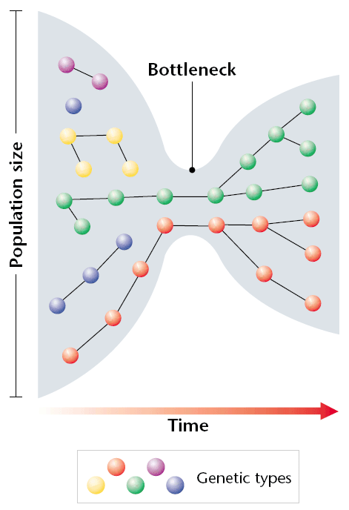
Species and Population Survival

Slide 17
Medical and Industrial Uses
About one quarter of the drugs prescribed in the United Sates are derived from plants, and almost all of the antibiotics are derived from chemicals found in fungi.
New chemicals and industrial materials may be developed from chemicals discovered in all kinds of species.
The scientific community continues to find new uses for biological material and genetic diversity.

Slide 18
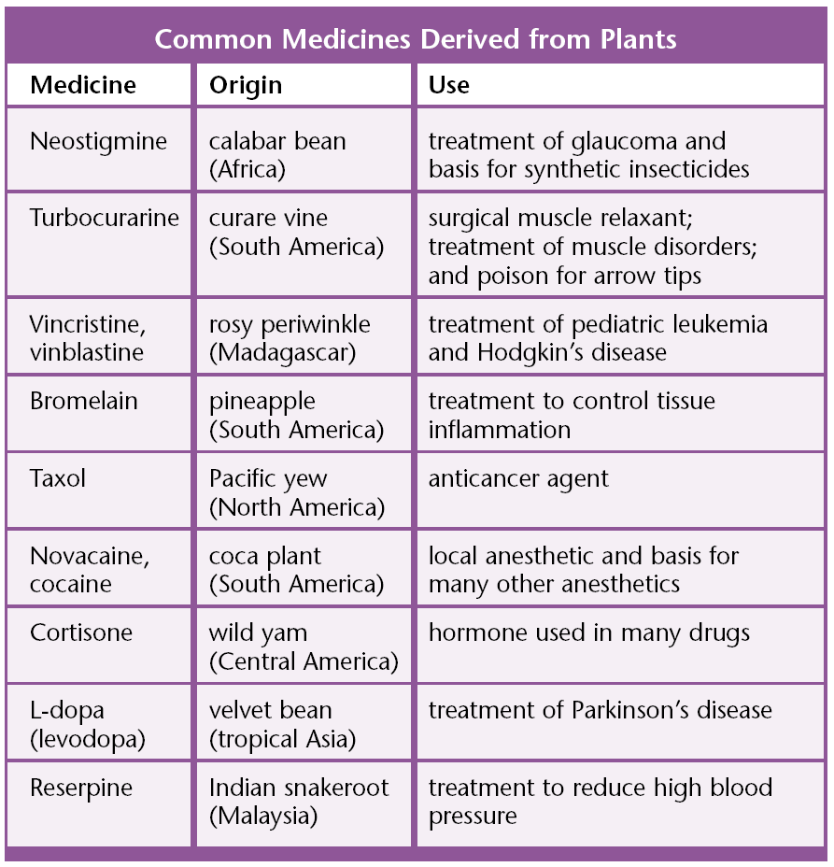
Medical Uses

Slide 19
Agricultural Uses
Most of the crops produced around the world originated from a few areas of high biodiversity.
Most new crop varieties are hybrids, or crops developed by combing genetic material from other populations.
History has shown that depending on too few plants for food is risky. Famines have resulted when an important crop was wiped out by disease. But some crops have been saved by crossbreeding them with wild plant relatives.

Slide 20
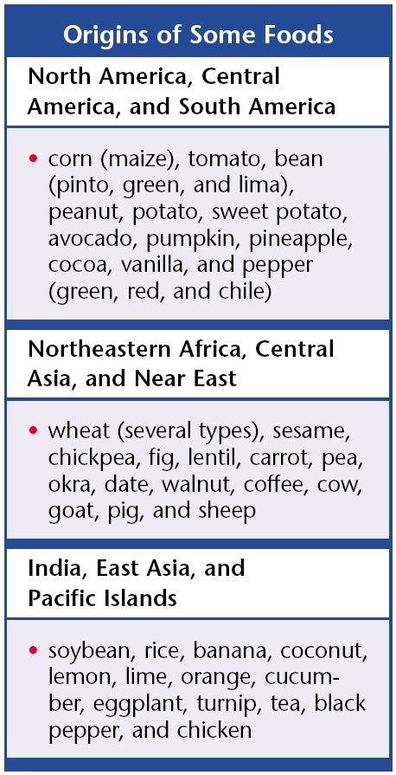
Agricultural Uses

Slide 21
Ethics, Aesthetics, and Recreation
Some people believe that we should preserve biodiversity for ethical reasons. They believe that species and ecosystems have a right to exist whether or not they have any other value.
People also value biodiversity for aesthetic or personal enjoyment such as keeping pets, camping, picking flowers, or watching wildlife.
Ecotourism is a form of tourism that supports the conservation and sustainable development of ecologically unique areas.

Slide 22
Monoculture
The growing on one species of organism, such as a lawn, a wheat field or cornfield.
Because all of the species are identical, there are few complex food webs and more diseases can spread quickly.
Monoculture often requires extensive use of pesticides and herbicides.

Slide 23
Monoculture
Humans often try to reduce diversity because it is easier to harvest crop if it all contains the same species.
Diversity Index – tells us how diverse a pollulation is, the more diverse, the healthy the habitat is.

